Slide 1
Strategy Is Born from Perception
Our Risk Focused Approach To Wealth Management

Slide 2
WHAT’S IMPORTANT ABOUT MONEY TO YOU?
Security?
Education?
Freedom?
Travel?
Providing For Your Loved Ones?
Legacy?
Retirement?
Really…
It’s Personal...
DREAM BIG!

Slide 3
RISK IS REAL!
The Only Thing Standing Between You and Your Dream Is Risk
Market Volatility Is Greater Than Ever Before
High Volatility = Risk!
The Financial Crisis of 2008-2009
Un-Prepared Investors Experienced Devastating Losses of Up To 60%
Capture Market Returns While Crushing Risk!
AVOID CATASTROPHIC EVENTS FROM DESTROYING YOUR LIFE

Slide 4
Year | Starting Value | Ending Value | Annual Change (%) |  | Year | Starting Value | Ending Value | Annual Change (%) |  | Year | Starting Value | Ending Value | Annual Change (%)
1957 | $46.67 | $39.99 | -14.31 |  | 1979 | $96.11 | $107.94 | 12.31 |  | 2001 | $1,320.28 | $1,148.08 | -13.04
1958 | $39.99 | $55.21 | 38.06 |  | 1980 | $107.94 | $135.76 | 25.77 |  | 2002 | $1,148.08 | 879.82 | -23.37
1959 | $55.21 | $59.89 | 8.48 |  | 1981 | $135.76 | $122.55 | -9.73 |  | 2003 | $879.82 | $1,111.92 | 26.38
1960 | $59.89 | $58.11 | -2.97 |  | 1982 | $122.55 | $140.64 | 14.76 |  | 2004 | $1,111.92 | $1,211.92 | 8.99
1961 | $58.11 | $71.55 | 23.13 |  | 1983 | $140.64 | $164.93 | 17.27 |  | 2005 | $1,211.92 | $1,248.29 | 3.00
1962 | $71.55 | $63.10 | -11.81 |  | 1984 | $164.93 | $167.24 | 1.40 |  | 2006 | $1,248.29 | $1,418.30 | 13.62
1963 | $63.10 | $75.02 | 18.89 |  | 1985 | $167.24 | $211.28 | 26.33 |  | 2007 | $1,418.30 | $1,468.36 | 3.53
1964 | $75.02 | $84.75 | 12.97 |  | 1986 | $211.28 | $242.17 | 14.62 |  | 2008 | $1,468.36 | 903.26 | -38.49
1965 | $84.75 | $92.43 | 9.06 |  | 1987 | $242.17 | $247.08 | 2.03 |  | 2009 | $903.26 | $1,115.10 | 23.45
1966 | $92.43 | $80.33 | -13.09 |  | 1988 | $247.08 | $277.72 | 12.40 |  | 2010 | $1,115.10 | $1,257.64 | 12.78
1967 | $80.33 | $96.47 | 20.09 |  | 1989 | $277.72 | $353.40 | 27.25 |  | 2011 | $1,257.64 | $1,257.60 | 0.00
1968 | $96.47 | $103.86 | 7.66 |  | 1990 | $353.40 | $330.22 | -6.56 |  | 2012 | $1,257.60 | $1,426.19 | 13.41
1969 | $103.86 | $92.06 | -11.36 |  | 1991 | $330.22 | $417.09 | 26.31 |  | 2013 | $1,426.19 | $1,848.36 | 29.60
1970 | $92.06 | $92.15 | 0.10 |  | 1992 | $417.09 | $435.71 | 4.46 |  | 2014 | $1,848.36 | $2,058.90 | 11.39
1971 | $92.15 | $101.95 | 10.63 |  | 1993 | $435.71 | $466.45 | 7.06 |  | 2015 | $2,058.90 | $2,043.94 | -0.73
1972 | $101.95 | $118.05 | 15.79 |  | 1994 | $466.45 | $459.27 | -1.54 |  | 2016 | $2,043.94 | $2,238.83 | 9.54
1973 | $118.05 | $97.55 | -17.37 |  | 1995 | $459.27 | $615.93 | 34.11 |  | 2017 | $2,238.83 | $2,673.61 | 19.42
1974 | $97.55 | $68.56 | -29.72 |  | 1996 | $615.93 | $740.74 | 20.26 |  | 2018 | $2,673.61 | $2,506.85 | -6.24
1975 | $68.56 | $90.19 | 31.55 |  | 1997 | $740.74 | $970.43 | 31.01
1976 | $90.19 | $107.46 | 19.15 |  | 1998 | $970.43 | $1,229.23 | 26.67 |  | Annual Loss Greater Than 15%
1977 | $107.46 | $95.10 | -11.50 |  | 1999 | $1,229.23 | $1,469.25 | 19.53 |  | Annual Loss of 10%-15%
1978 | $95.10 | $96.11 | 1.06 |  | 2000 | $1,469.25 | $1,320.28 | -10.14 |  | Annual Loss Less Than 10%
S&P 500 Index ~ Historical Performance Since 1957

Slide 5
Our First Priority Is Asset Preservation and
The Growth Of Your Wealth.
Event
2000-2002 - DotCom Crash
2001 - Attacks of September 11th
2007-2009 - Housing/Credit Crisis
What The Market Did
Nasdaq Composite Lost 78% of Value
$1.4 trillion of Market Value Lost
DJIA Declined 14%
S&P 500 Declined 11.6%
S&P 500 Declined 57.8%

Slide 6
Historical Period | Start Date | Duration in Months | S&P 500 Percent Change | Subsequent Market Correction
Recovery from the Great Depression | June 1932 | 57 | 325% | March 1937 - April 1942 -60%
WWII | April 1942 | 49 | 158% | May 1946 - June 1949 -30%
Post-war Boom | June 1949 | 86 | 266% | August 1956 - October 1957 -22%
Cold War ramps up | Oct, 1957 | 50 | 86% | December 1961 - June 1962 -28%
JFK aims to "get America moving again" | June 1962 | 44 | 80% | February 1966 - October 1966 -22%
The go-go years | Oct. 1966 | 26 | 48% | November 1968 - May 1970 -36%
Nifty Fifty | May 1970 | 32 | 74% | January 1973 - October 1974 -48%
A modest bull | Oct. 1974 | 74 | 126% | November 1980 - August 1982 -27%
Reaganomics | August 1982 | 60 | 229% | August 1987 - December 1987 -34%
Black Monday comeback | December 1987 | 31 | 65% | July 1990 - October 1990 -20%
Roaring 90's | October 1990 | 113 | 417% | March 2000 - October 2002 -49%
Housing Boom | October 2002 | 60 | 102% | October 2007 - March 2009 -57%
Current Long, slow recovery | March 2009 | 121 | 334% | TBD
How Will This Market Correction
Risk Impact You?
Your Portfolio |  | Bear Market Decline
Current Value | $876,000 | -48%
Potential Loss | -$420,480
Post Market Correction Value | $455,520
Historical Bull Markets and The Inevitable Market Corrections That Followed

Slide 7
Your Portfolio |  |  | Bear Market Decline
Current Value |  |  | -%
Potential Loss | -$
Post Market Correction Value | $
$
X
Portfolio Worksheet

Slide 8
If you could invest, grow wealth
and secure your future,
yet not worry about
losing your life
savings…
What Would You Do?
What Do You Want From Your Advisory Partner?

Slide 9
At JP Lotito & Company
we start with the end in mind.
We manage risk to preserve capital and capture returns.
Seek to reduce volatility and danger from cataclysmic events such as 9/11 and the Financial Crisis of 2008-2009
Safeguard your money. Preserve your wealth. Secure your future.
Transfer risk from you to our asset manager partners.
Extract returns from markets instead of trying to outsmart it.
Identify and secure lifetime income you cannot outlive.

Slide 10
Our firm’s Process & Experience, combined with our Management Methods, skillfully implemented, is what Separates us from other advisors...
Discover our proprietary client/investment process
Profit from our customized, hands-on, Active Management and Advisory Services
Benefit from our deep dive investment analysis
Discover true value from your personal Client Proposal and Investment Policy Statement

Slide 11
If A 2008-like Bear Market Were To Happen Again…
Expected Performance
Expected Performance
Expected Performance
Jan 1, 2008 – Dec 31, 2008
High Risk
Moderate Risk
Low Risk
S&P 500 Index
-$40,800 (-40.8%)
-$24,100 (-24.1%)
-$2,200 (-2.2%)
(-53.1%)
If The Financial Crisis Were To Happen Again…
Expected Performance
Expected Performance
Expected Performance
Oct 15, 2007– Mar 2, 2009
High Risk
Moderate Risk
Low Risk
S&P 500 Index
-$58,330 (-58.3%)
-$35,200 (-35.2%)
-$4,400 (-4.4%)
(-53.1%)
If A 2013-like Bull Market Were To Happen Again…
Expected Performance
Expected Performance
Expected Performance
Jan 1, 2013 – Dec 31,2013
High Risk
Moderate Risk
Low Risk
S&P 500 Index
+$33,690 (+33.7%)
+$21,200 (+21.2%)
+$4,500 (+4.5%)
(+32.3%)
If A 134bps Interest Rate Spike Were To Happen Again…
Aggregate Bond Index
Expected Performance
Expected Performance
Expected Performance
May 1, 2013 – Sep 5, 2013
High Risk
Moderate Risk
Low Risk
+$4,710 (+4.7%)
+$2,500 (+2.5%)
+$800 (+0.8%)
(-5.1%)
Case Study : Historic Market Events In Relation To A Portfolio Based On Risk Score

Slide 12
We Begin By Identifying Your Tolerance For Risk. Next We Quantify That Risk With Patent Protected Algorithms & Software
Compliment Equities with asset protected strategies
Reduce exposure to unprotected securities through non-correlated assets
Apply Macro and Micro hedging and call options to generate income
Risk Score | Asset Allocation |  | Cash/Other
 | Managed | Protected
85 | 100% Stocks | 0% | 0%
 | 0% Bonds
65 | 35% Stocks | 50% | 5%
 | 10% Bonds
35 | 10% Stocks | 60% | 10%
 | 20% Bonds

Slide 13
OUR PROCESS PUTS YOU IN CONTROL
Personal Risk Analysis
Portfolio Risk Analysis
Assign Risk Score
Analysis & Assign A Risk Score
Set Allocation & Investment Rules
Establish New Rules
Determine Asset Allocation
Create Investment Policy Statement
New Risk Adjusted Asset Allocation
Establish Portfolio
Core ~ Essential ~ Specialized
Execution
Core
Essential
Special

Slide 14
Three Spheres of Strength
CORE: Asset protected investments designed for long term growth and income.
ESSENTIAL: Liquid, exchange traded, dividend paying securities.
SPECIALIZED: Option and Hedging strategies to capture short term ALPHA.
CORE
ESSENTIAL
SPECIAL

Slide 15
HOW DO WE TRANSFER RISK?
We Partner With
The Largest and Best
Asset Managers In The World!
They Specialize In Risk Mitigation
$588.7 Billion
$78.2 Billion
$586 Billion
$1.4 Trillion
$242 Billion
Notes:
add AUM

Slide 16
With Our High-Tech, High-Touch Approach
We Reduce Risk Without Sacrificing Reward
STRUCTURE BASED ON SCIENCE
PERSONAL MANAGEMENT WITH YOUR FUTURE IN MIND
Risk Analysis
Risk Score
Investment Policy Statement
Asset Allocation
Plan Execution
Market Adjustments/Hedging
ALPHA Generation
Combined 50+ Years Experience
A Commitment To Keeping In Touch
Phone/Email/Video Conferencing/Face-to-Face
Access 24/7 Through Our Investment Hotline
Quarterly Review
Annual Meeting

Slide 17
Your
Investment Policy
Statement
Every Client of
JP Lotito & Company
is provided a Customized
A Blueprint of Your Portfolio
The Road Map To Your Financial Success
Your Tolerance For Risk and Anticipated Reward
Your Hopes and Dreams
Your Future!
Investment Policy Statement “IPS”
Our IPS Is The Gold Standard - Similar To Institutional Pros
A Deep Dive Into Your Personal & Financial Goals

Slide 18
Call To Action!
Discover Your Risk Score!
Find Out How Understanding Your Risk Score Could Save Your Financial Future
Does your portfolio risk match your risk tolerance?

Slide 19
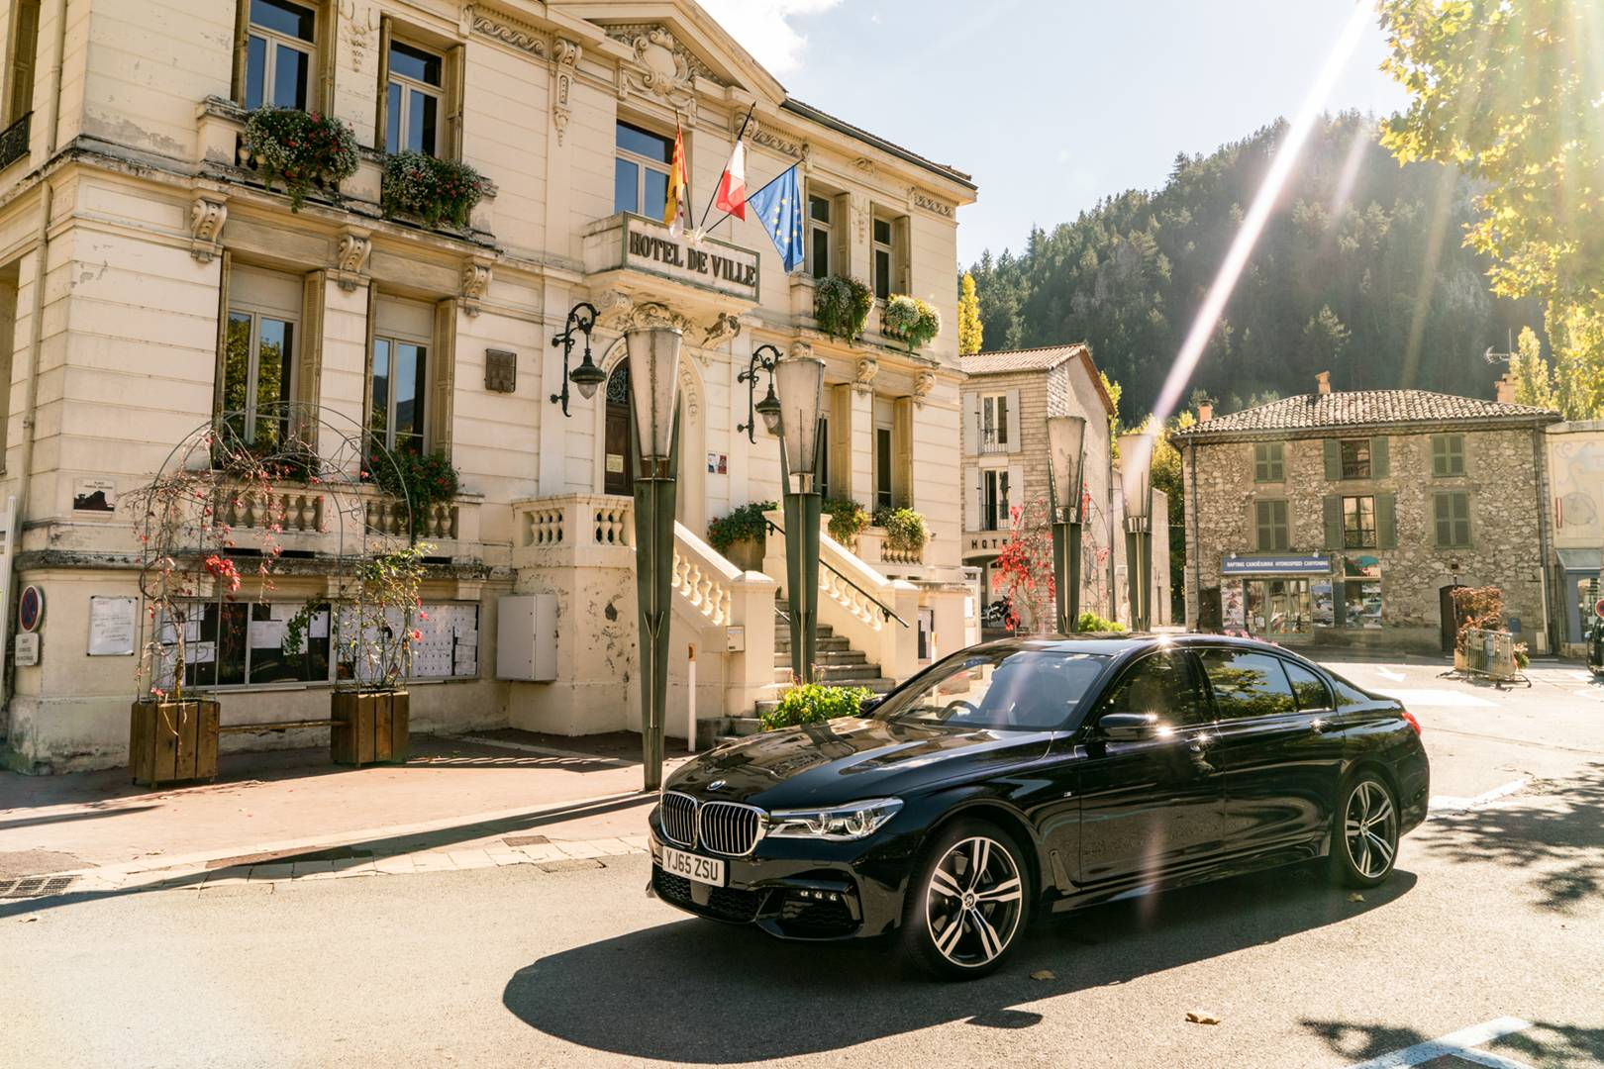
WHERE DO YOU BEGIN?
1
Take Your Personalized Risk Evaluation
2
Provide Us Access To Your Financial Portfolio So That We May Perform A Current Risk Analysis
3
Meet With Our Team
4
Review Your Custom Proposal
5
Gain Peace of Mind and Enjoy Financial Growth Without Fear!

